Slide 1
E-Court Mobile Application Platform System
By
Student Name(s)
Reg No(s)
Supervisor
Dr Collins Oduor
United States International University-Africa
Nairobi, Kenya

Slide 2
Outline
Introduction and problem statement
Systems Design and Development Objectives
Research Objective
Project Challenges
Results and Findings
Business benefits
Recommendations , Conclusion and future work

Slide 3
Introduction & Problem Statement
Today’s education is characterised by technology-enhanced learning
Gamification supports and motivates students, and can thus lead to enhanced learning processes and outcomes
The main aim of gamifying learning is to motivate students to study or earn new knowledge in a more appealing, more comfortable, competitive and entertaining way
Problem
  There is a high dropout rate among students in the Department of Computer Science at the University of Namibia (UNAM)
  Lack of engaging methods to facilitate learning both basic and advanced computational concepts
  Lack of engaging methods to facilitate learning both basic and advanced computational concepts

Slide 4

Pictorial or video of the main problem
Add video or a picture or image show the major problem being solved i.e locust menace

Slide 5
Significance of the study
This paper is relevant to Sustainable Development Goal (SDG) 4, specifically, to
  “substantially increase the number of youth and adults who have relevant skills, including technical and vocational skills, for employment, decent jobs and entrepreneurship”
This can be achieved when teaching and understanding of learning materials are presented interestingly
An effective way of achieving this is by gamifying the learning environment
This study contributes to achieving SDG 4 within the Namibian context by attempting to improve the learning approaches through gamification

Slide 6
Research Objectives
Overall goal
  To design, develop and evaluate a gamified mobile application to support the learning of basic and advanced computational concepts in the Department of Computer Science at UNAM
Systems design and development objectives
  Geo-location
  System reports
  E-payments
  Notifications via email or sms

Slide 7
Research Objectives
Systems research objectives
  To find out the challenges in the traditional teaching of computer science
  To determine the benefits for Design, develop and evaluate a contextualised gamified app for teaching modules in the teaching of computer science

Slide 8
Literature Review
Summary of review and comparison of the exciting related systems
Features | Name and country of systems 1 | Name and country of systems 2 | Name and country of systems 3
Cost | X | X | X
Easy to Install | X | X | X
Easy to use | X | X | X
Efficient Database | X | X | X
Good Security | Tick | Tick | Tick
Vulnerability assessment | Tick | Tick | Tick
Based on the above review , my system stands out because of:-
1.
2.
3

Slide 9
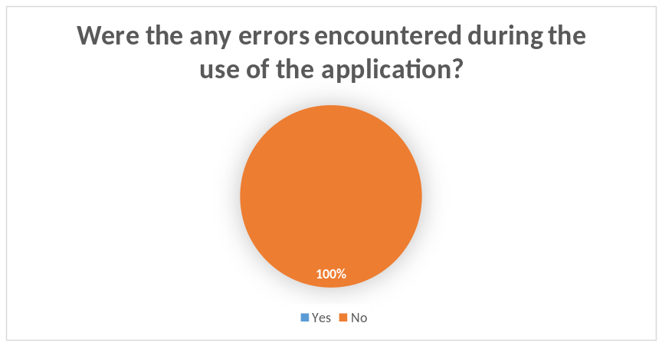
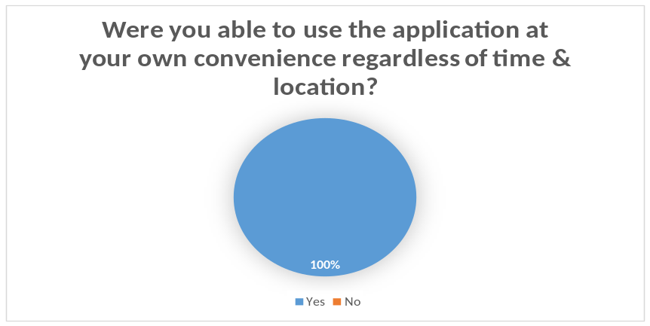
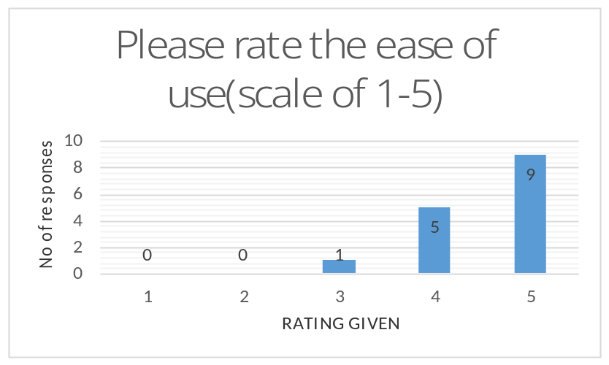
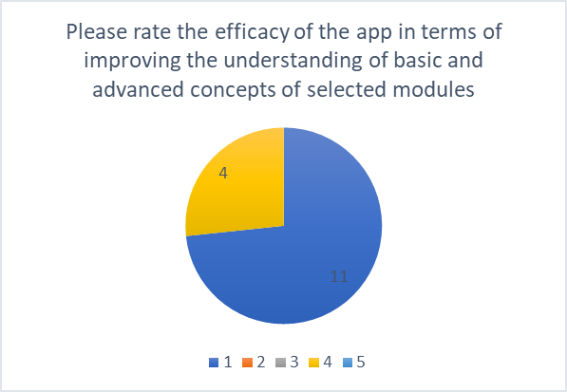
Main Results and Findings

Slide 10
Main Results and Findings

Slide 11
Recommendations,Conclusions and future work
Recommendations
This paper presented:
  The design, development and evaluation of CS Challenger\
  The design, development and evaluation of CS Challenger\
Conclusions
The app is capable of improving learning outcomes in the Department of Computer Science at UNAM, thereby reducing dropout rates in the department
Future work
  incorporate all the modules offered by the Computer Science department into the app and to upload the final version on Google Play Store where students can download the app for free
  app can be customised to meet the needs of students in other departments and institutions

Slide 12
Social/Community/Economic Business benefits
Enhanced learning through interactive gaming interactions
Potential to reduce dropout rates in the Department of Computer Science at UNAM
  interactive gaming approach which offers rankings and rewards
  provides a motivating environment in which students can quickly grasp the concept of a subject
  Apart from the leader board component, the app does not require internet connectivity to function, thereby increasing the usability of the app as students are less constrained in using the app

Slide 13
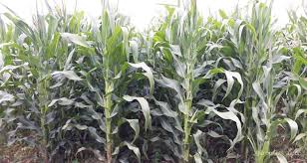
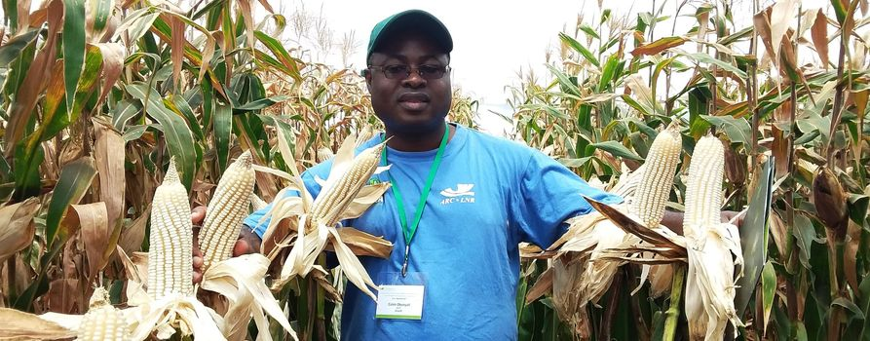
Picture or video of expected outcome of the project

Slide 14


Picture or video of expected outcome of the project

Slide 15
SYSTEMS DEMONSTRATION

Slide 16
END OF PRESENTATION
ANY QUESTIONS/COMMENTS
THANK YOU

